Slide 1
2CS701 Compiler Construction
Lab Session

Slide 2
Tools for Compiler Construction Laboratory
Lex / Flex Information
Lex: is a tool to generate lexical analyzers.
divides a stream of input characters into meaningful units (lexemes), identifies them (token) and may pass the token to a parser generator, yacc
Lex specifications are regular expressions
Flex: (fast lexical analyzer generator)
  Free and opensource

Slide 3
General Yacc/Bison Information
YACC:- Yet Another Compiler Compiler
  It is a tool to generate parsers
Bison
  It is a tool to generate parsers
  Open source and free

Slide 4
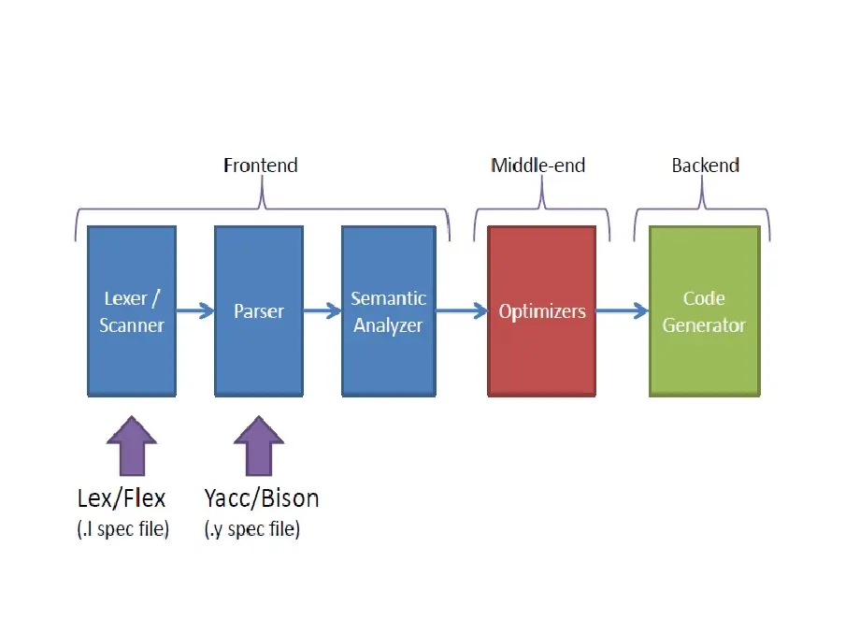
Flex and Bison Relation

Slide 5
Installation of Flex/Lex and Yacc/Bison
On Linux
  $ sudo apt install flex
  $ sudo apt install bison
On windows
  Download Flex from: https://sourceforge.net/projects/winflexbison/
  Download Bison from: https://sourceforge.net/projects/winflexbison/
  Download DevC++
  Install Flex at "C:\GnuWin32"
  Install Bison at "C:\GnuWin32"
  Install DevC++ at "C:\Dev-Cpp"
  Open Environment Variables.
  Add "C:\GnuWin32\bin;C:\Dev-Cpp\bin;" to path.
http://www.surajgaikwad.com/2013/10/compile-lex-and-yacc-progs-on-windows.html
On iOs
  $ brew install flex
  $ brew install bison

Slide 6
Format for Lex Programs
...definition section ...
%{
Include<stdio.h>
%}
%%
... rules section ...
%%
... user subroutines ...

Slide 7
The definition section can include the
  literal block, definitions, internal table declarations, start conditions, and translations
The Rules section contains pattern lines and C code.
  A line that starts with whitespace, or material enclosed in “%{” and “%}” is C code. A line that starts with anything else is a pattern line.
  C code lines are copied verbatim to the generated C file. ...
User Subroutine
main() {
yylex();
}

Slide 8
Lex program to count the number of vowels and consonants in a given string
Input: Hello everyone
Output: Number of vowels are: 6
Number of consonants are: 7

Slide 9
%{
#include<stdio.h>
#include<string.h>
int vow_count=0;
int conso_count =0;
%}

Slide 10
%%
"\n" return 0;
[\t]+ ;
[aeiou]+ {vow_count++;}
[a-zA-Z] {conso_count++;}
%%

Slide 11
int main()
{
printf("Enter the string of vowels and consonents:");
yylex();
printf("\nNumer of Vowels are %d and Consonants are %d", vow_count, conso_count);
return 0;
}
int yywrap(){
return 0;
}
int yyerror(){
return 0;
}

Slide 12
Execution of a Lex program
$ vi Program1.l
$ Lex Program1.l
  Will generate the file lex.yy.c
$ gcc lex.yy.c
$ ./a.out

